Slide 1



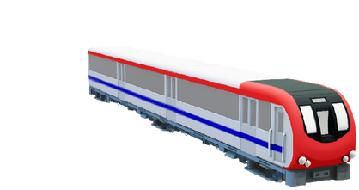
DS Group Project
Railway
Management
System

Slide 2






Meet Our Team
MANUSHI OZA
YAGNA PATEL
MANSI PARMAR
DHAIRYA PATEL
VIRTI SHAH
S1 31
CE
21002170110083
S1 05
CE
21002170110128
S1 11
IT
21002170210056
S1 06
IT
21002170210060
S1 02
CE
21002170110208

Slide 3

Introduction
01
02
03
This System is basically concerned with the railway management system.
Completely coded in C Programming language using Linked List and File handling
This system ensures the user to view trains of his desired destination, Book/Cancel ticket etc.
2

Slide 4

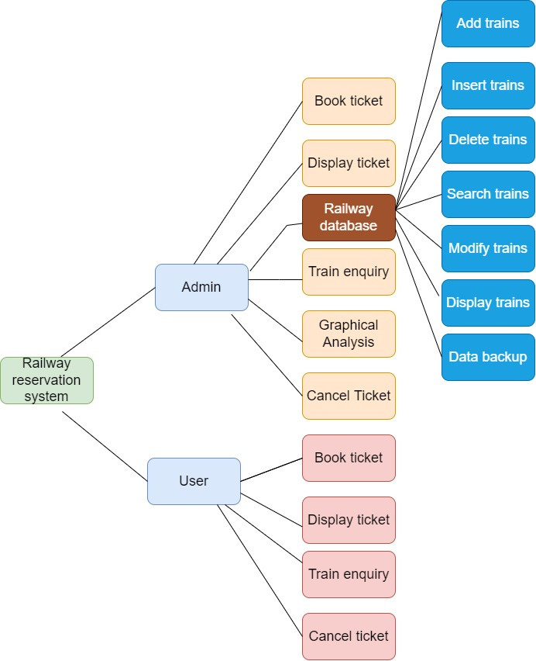
Diagram
4

Slide 5
Advantages
Linked List
File Handling
Security
No Memory Wastage.
Easily Data is Stored
&
Database can be Created.
Authentication will be Done by password checking.
5

Slide 6


Linked List &
File Handing
Array &
Runtime Storage
Linked List stores the data wherever in the memory.
File Handling is used for Permanent Storage.
Array has defined memory allocations.
Information kept in the RAM is temporary i.e. till the program terminates.
7

Slide 7
Thank You!!
4

